Slide 1
DOCKER PRACTICE

Slide 2
Docker basic concept
Docker image
Docer container
hub

Slide 3
install
Ubuntu 16 lts

Slide 4
Docker image
ubuntu
alpine

Slide 5
Dokcer hub
https://hub.docker.com/repository/docker/yiyang2009/iris

Slide 6
github
https://github.com/haixiang1977/iris/tree/master

Slide 7
architect
hyacinth
mosquitto
redis
petunia
azalea
docker
docker
docker
docker
docker
Ubuntu 16.04 LTS

Slide 8
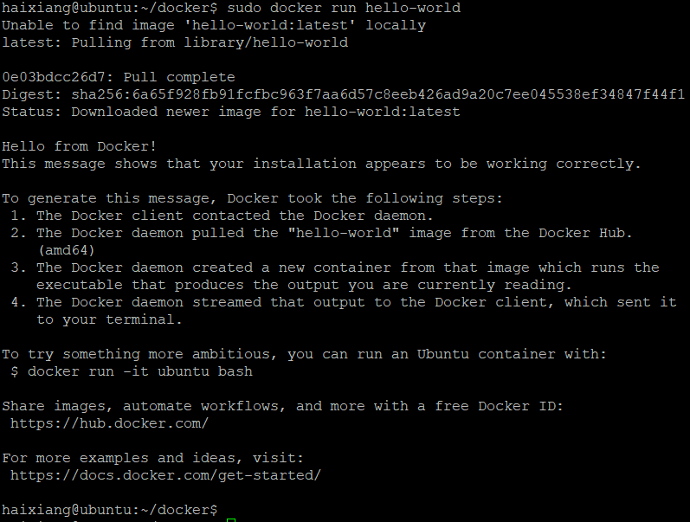
Install on ubuntu
https://docs.docker.com/engine/install/ubuntu/

Slide 9
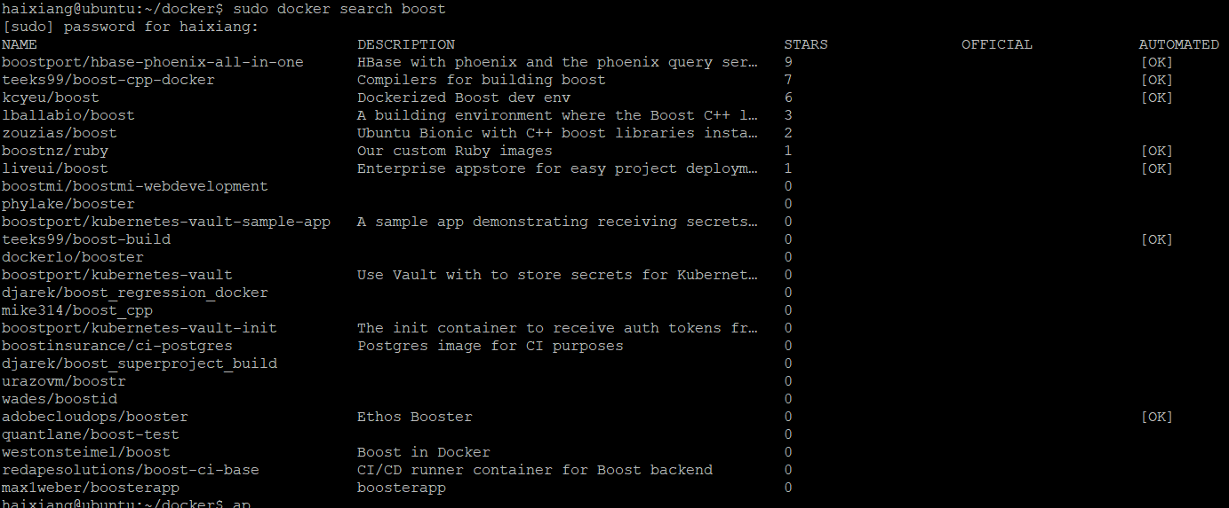
Find boost image
Sudo docker search boost – no official image

Slide 10
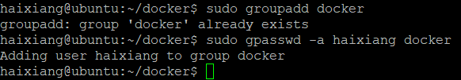
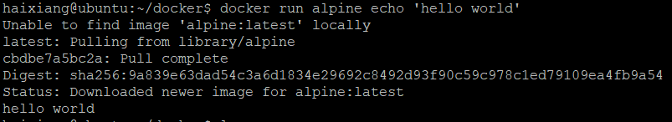
Run docker without sudo
https://askubuntu.com/questions/477551/how-can-i-use-docker-without-sudo

Slide 11
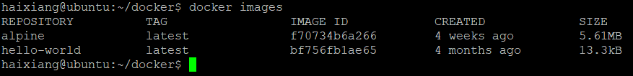
Check local installed image
docker images ls

Slide 12
Start from ubuntu image
To familiar docker operation first
Next is alpine image

Slide 13
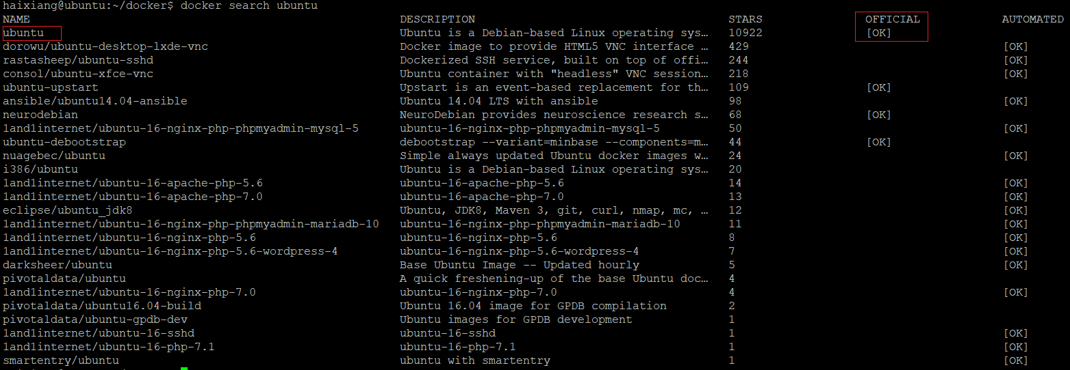
Start from ubuntu image
Search ubuntu image

Slide 14
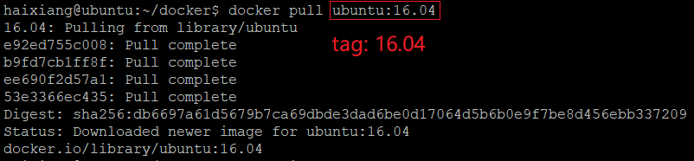
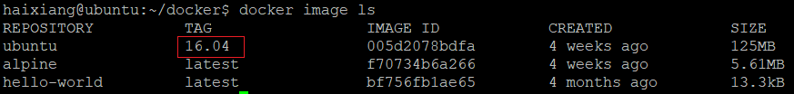
Start from ubuntu image (cont.)
Pull ubuntu 16.04 docker image

Slide 15
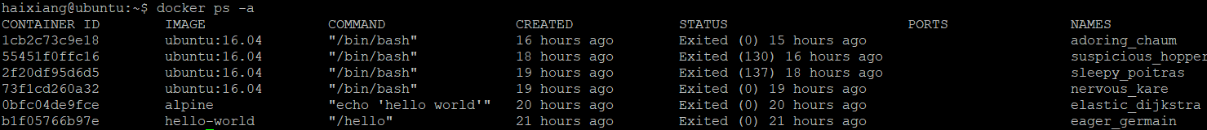
Start from ubuntu image (cont.)
Display all containers
Docker ps –a

Slide 16
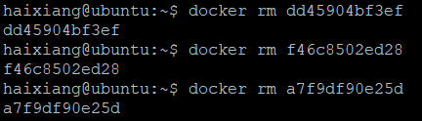
Start from ubuntu image (cont.)
Before remove docker image, you must remove docker contains first

Slide 17
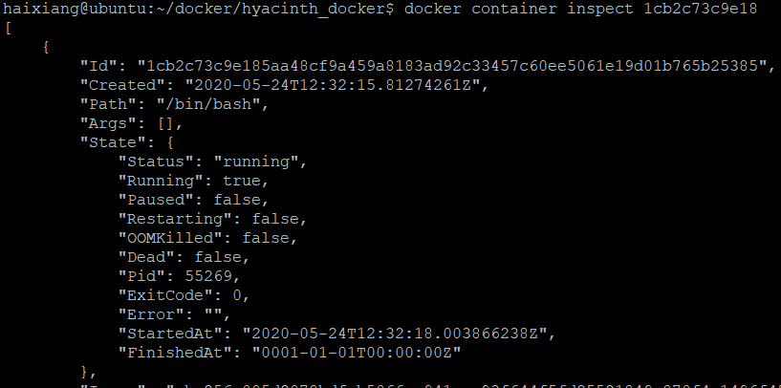
Start from ubuntu image (cont.)
Checking running port and ip

Slide 18
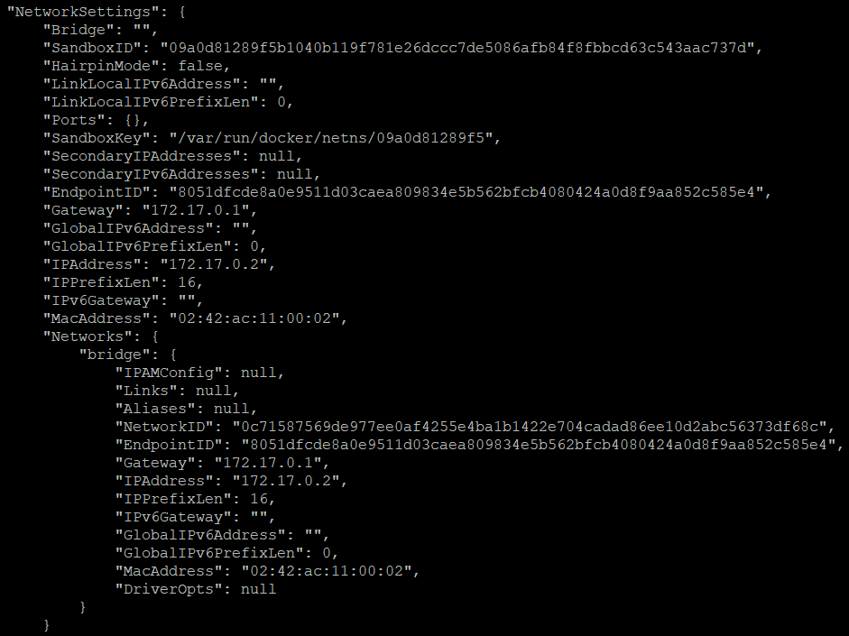
Start from ubuntu image (cont.)
Checking running port and ip (cont.)

Slide 19
Build stage docker image – from container
Create ubuntu:16.04 container from ubuntu:16.04 image with /bin/bash and start
docker run -it ubuntu:16.04 /bin/bash

Slide 20
Build stage docker image – from container
Create ubuntu:16.04 container from ubuntu:16.04 image with /bin/bash and start
Install hyacinth components into container
Install dependancies
build boost
build mqtt mosquitto
build hyacinth

Slide 21
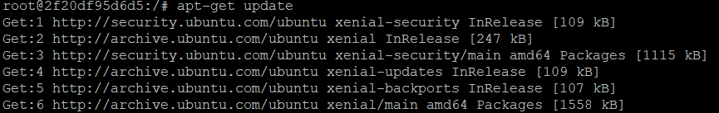
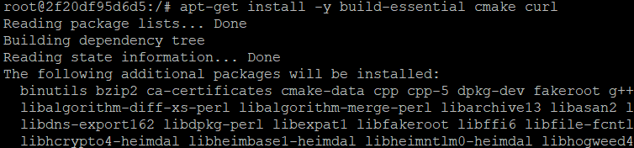
Build stage docker image – from container
Install packages

Slide 22
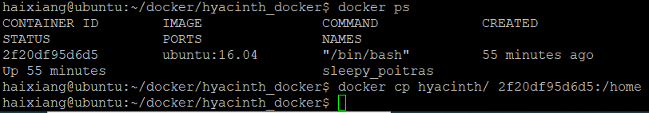
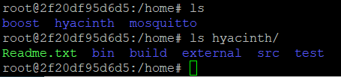
Build stage docker image – from container
Build dependency boost, mosquito
COPY source code to running container
Host side docker copy
Container side

Slide 23

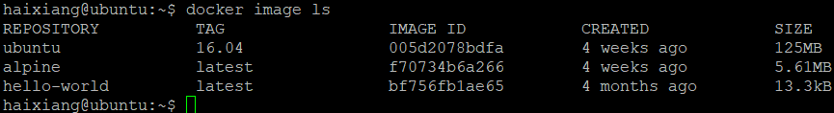
Build stage docker image – from container
Exit docker and docker commit to generate a new image

Slide 24
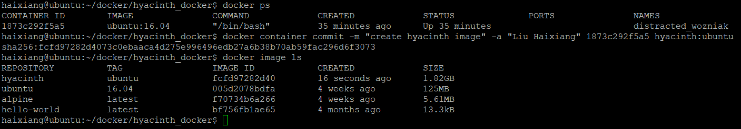
Build stage docker image (cont.)
Exit docker and docker commit to generate a new image

Slide 25
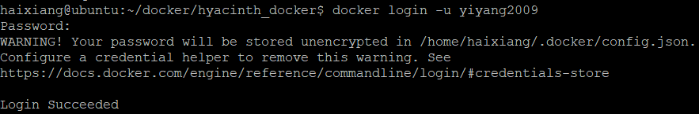
Commit to docker hub
Docker login

Slide 26
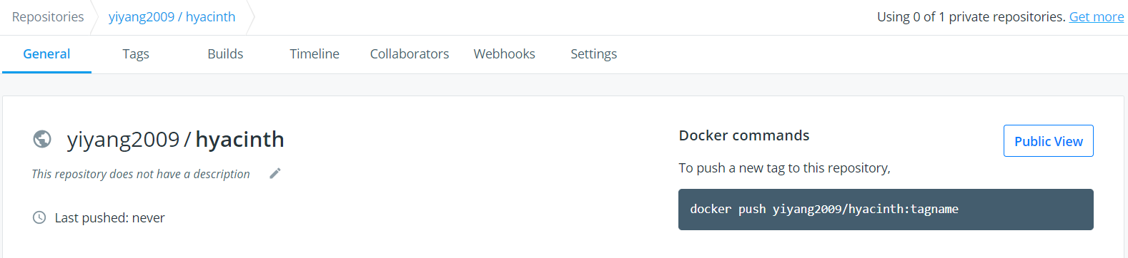
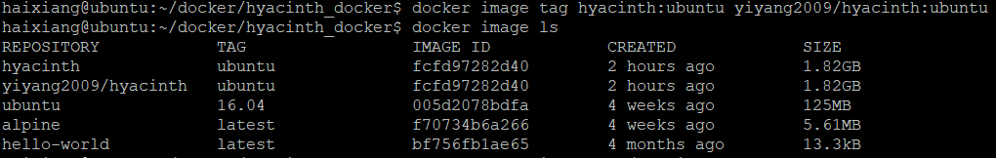
Commit to docker hub (cont.)
Change tag name to match repo

Slide 27
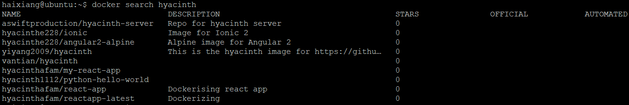
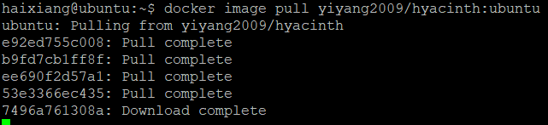
Commit to docker hub (cont.)
Verify image from docker hub

Slide 28

Commit to docker hub (cont.)
Verify image from docker hub
Run container from the image

Slide 29
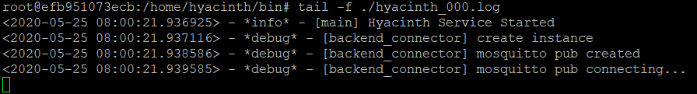
Commit to docker hub (cont.)
Run application

Slide 30
Use docker file create image
Multi-stage build
Build stage docker image
Run-time stage docker image
TO BE DONE

Slide 31
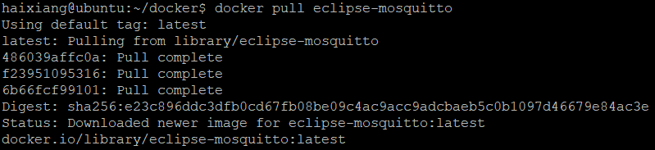
MOSQUITTO IMAGE
Official image from https://hub.docker.com/_/eclipse-mosquitto

Slide 32
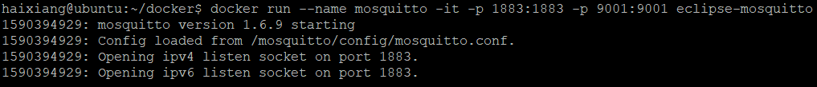
MOSQUITTO IMAGE (cont.)
Run mosquito image as container

Slide 33
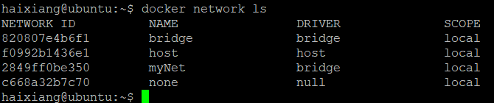
Connect mosquito with hyacinth
Create a network

Slide 34
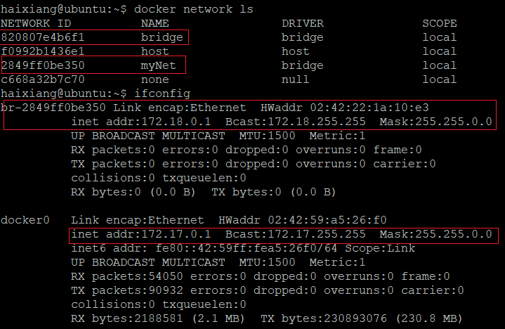
Connect mosquito with hyacinth
Create a network (cont.)
By default use bridge (docker0), so ip addr range is 172.17.x.x

Slide 35
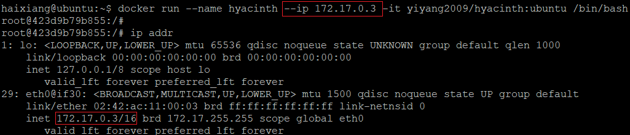
Connect mosquito with hyacinth
ASSIGN mosquito container with ip addr
ASSIGN HYACINTH CONTAINER WITH IP ADDR

Slide 36

Connect mosquito with hyacinth
Chang hyacinth ip addr to connect mosquitto

Slide 37
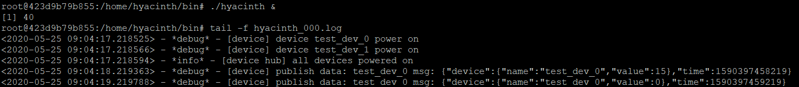
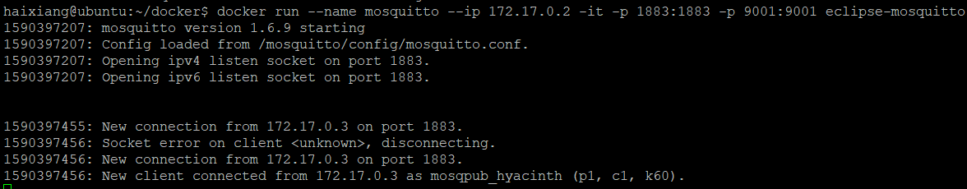
Connect mosquito with hyacinth

Slide 38
Connect mosquito with hyacinth
Host 127.0.0.1
MQTT Lens
Mosquitto container
172.17.0.2
1883
1883
Hyacinth container
172.17.0.3
client

Slide 39


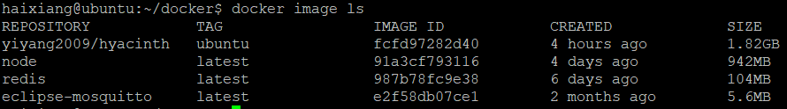
Install redis and node docker

Slide 40
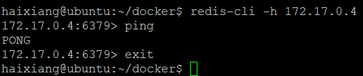
Install redis and node docker
Run redis

Slide 41
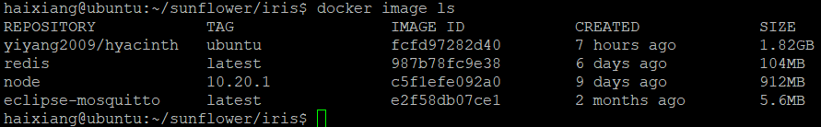
Use dockfile for Petunia
Download the node version 10.20.1, same as the node version in host

Slide 42
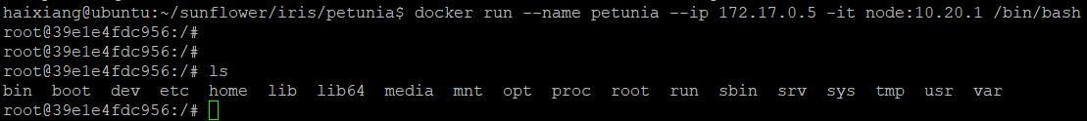

Use dockfile for Petunia (cont.)
Run bash command environment

Slide 43
Use dockfile for Petunia (cont.)
Install petunia

Slide 44
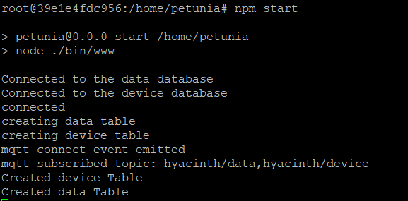
Use dockfile for Petunia (cont.)
Run petunia

Slide 45
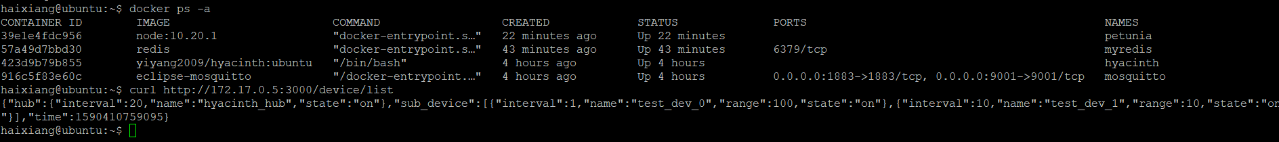
Use dockfile for Petunia (cont.)
Check with restapi

Slide 46
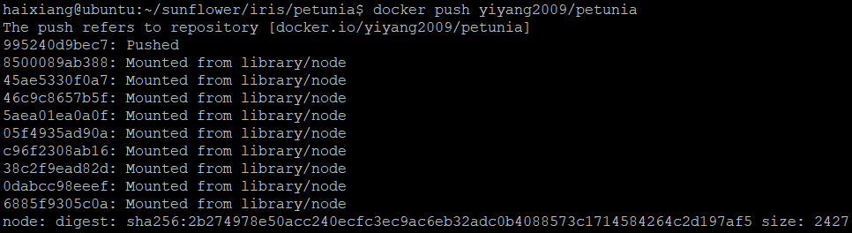
Use dockfile for Petunia (cont.)
Commit and push to dockhub

Slide 47
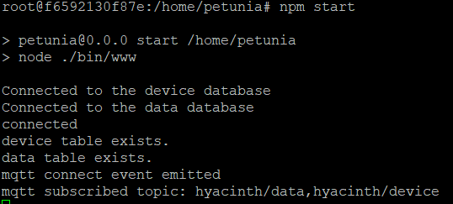
Use dockfile for Petunia (cont.)
Verify docker image

Slide 48
Use dockfile for azalea (cont.)
Download the node version 10.20.1, same as the node version in host
Same as petunia
Run bash command environment

Slide 49
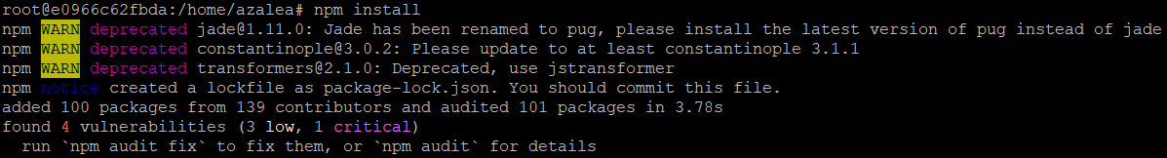
Use dockfile for azalea (cont.)
Install azalea
Run azalea

Slide 50

Use dockfile for azalea (cont.)
Run azalea (cont.)

Slide 51
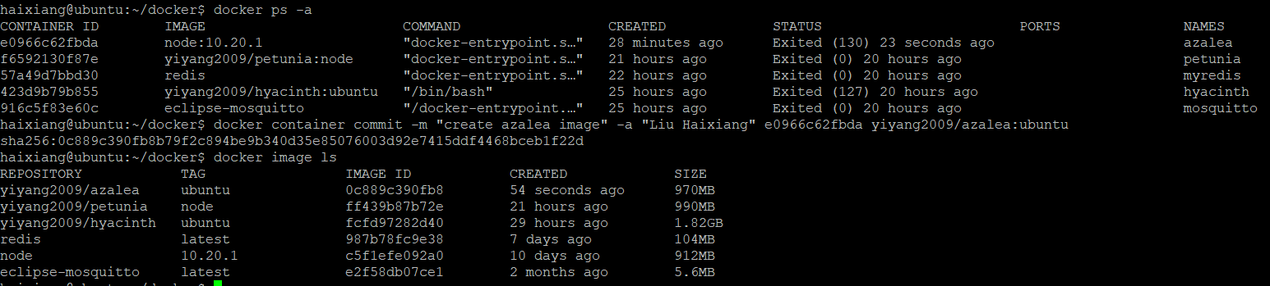
Use dockfile for azalea (cont.)
Commit docker image

Slide 52
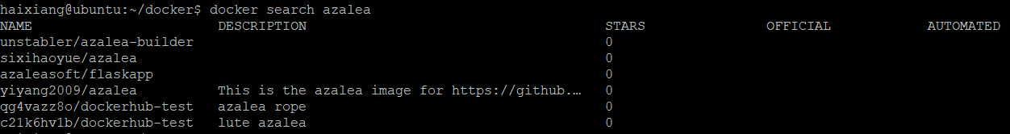
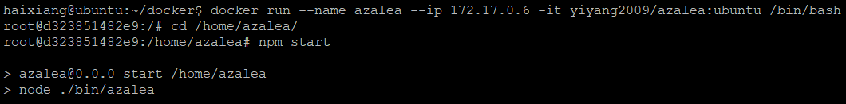
Use dockfile for azalea (cont.)
Verify image

Slide 53
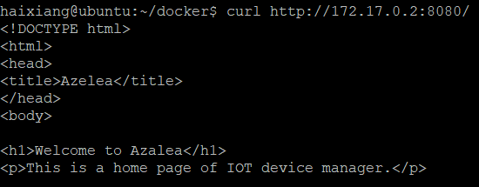
Use dockfile for azalea (cont.)
Verify image (cont.)

Slide 54
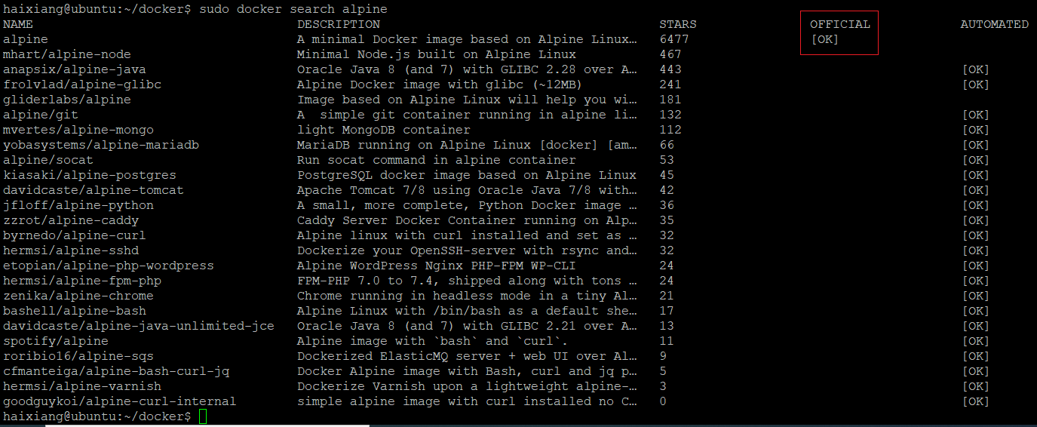
search alpine image
sudo docker search alpine

